Slide 1
Why Developers should love PowerShell
Kurt Kroeker

Slide 2




About Kurt
Sr. Software Developer at EnergyCAP, Inc. for 11 years
Lifelong Stage College, PA resident
Father of 4
Fiddler and multi-instrumentalist

Slide 3
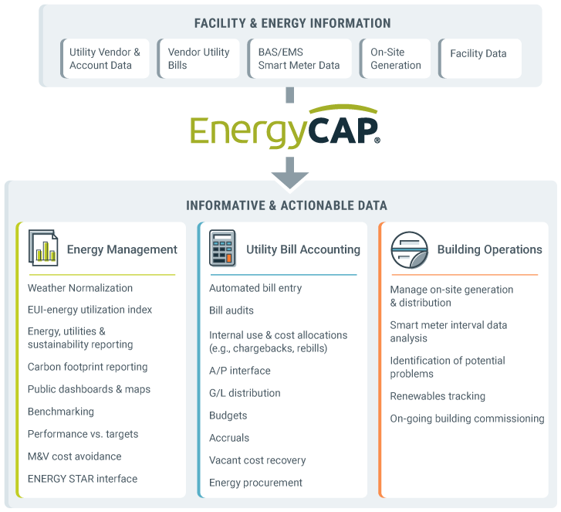
About EnergyCAP

Slide 4

About This Talk
Agenda
Talking
Kurt’s PowerShell Background
Why YOU should care about PowerShell
Demos
PowerShell Basics
Tips working with PowerShell
Resources
Q & A
This Photo by Unknown Author is licensed under CC BY-SA

Slide 5



Slide 6
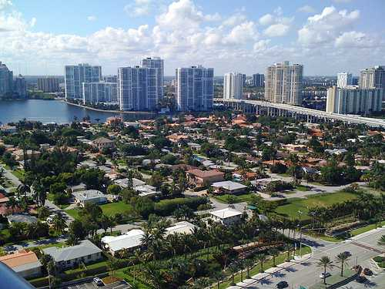


My Background with PowerShell
EDI
apis
audits
reformatter
reformatter
reformatter
reformatter
logging

Slide 7

Why should I care about PowerShell?
It is POWERFUL
It is EVERYWHERE
It is FAMILIAR

Slide 8
What is PowerShell?

Slide 9
PowerShell Concepts
PowerShell Console
Commandlets
Aliases
Variables
Script files
Functions
Operators
Pipelines

Slide 10
Tips Working with PowerShell
The tab key
Pipelines and $_.
Your PowerShell Profile
Up/Down arrows
Hash tables
Working with JSON, CSV, and XML
PowerShell ISE and VS Code
Get-Help, -Command, -Member

Slide 11
Gotchas
Working with strings
PowerShell and TLS
ExecutionPolicy
Calling assemblies with arguments
. Vs .\
Old code on the internet
Is it an array?

Slide 12
Subjects Not Demoed
Azure resource interactions
PC user and administrative management
GUIs and PowerShell
PSCustomObject creation
Add-Type to use DLLs
“Splatting” arguments
Try/Catch with PowerShell

Slide 13
Q & A

Slide 14
Resources
PowerShell Core project
https://github.com/PowerShell/PowerShell
Microsoft PowerShell SDK Docs
https://docs.microsoft.com/en-us/powershell/scripting/developer/windows-powershell?view=powershell-6
PS Gallery
https://www.powershellgallery.com
PowerShell 6 Cheat Sheet
https://ilovepowershell.com/powershell-cheat-sheet/
Unit Testing PS with Pester
https://devblogs.microsoft.com/scripting/what-is-pester-and-why-should-i-care/
ExecutionPolicy Management
https://docs.microsoft.com/en-us/powershell/module/microsoft.powershell.security/set-executionpolicy?view=powershell-6

Slide 15

Kurt Kroeker Sr. Software Engineer EnergyCAP, Inc.
Email: kurt.kroeker@energycap.com
Twitter: KurtKroeker

